Slide 1
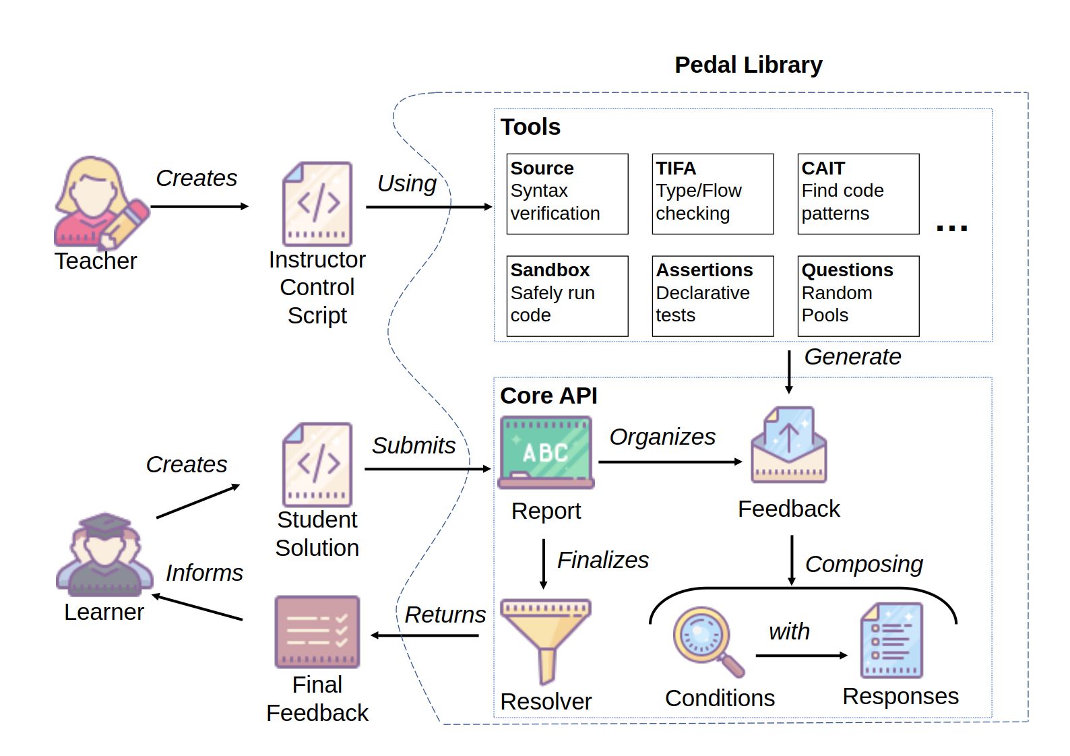
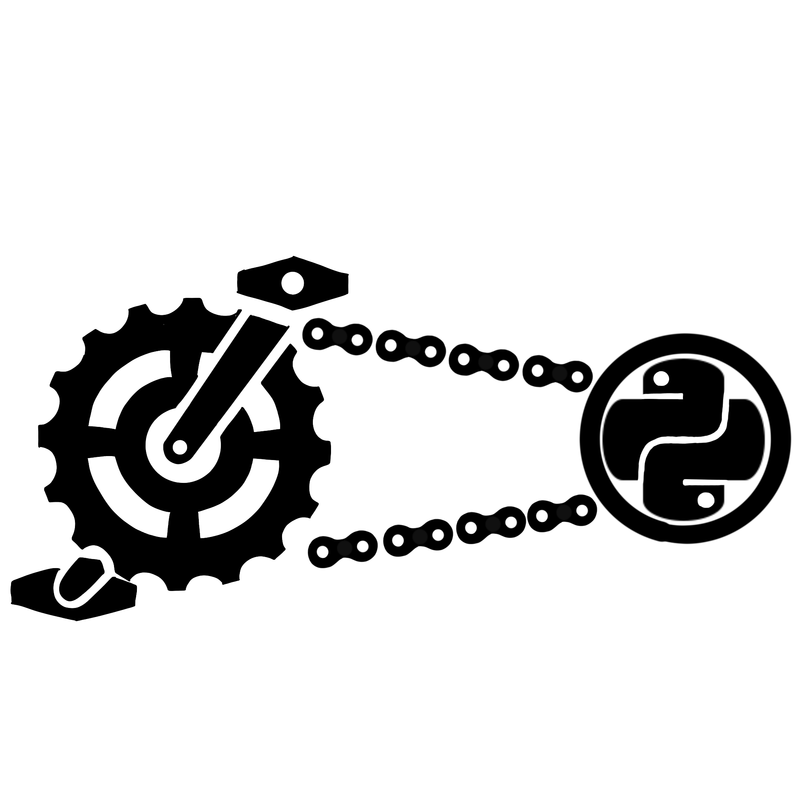





25-312
Java Pedagogical Libraries for Code Analysis
Team members: Derek Chiou, Luca Doutt, Ghulam Mujtaba Qasimi, Kennedy Westry | Faculty adviser: Luke Gusukuma, Ph.D. | Sponsor: VCU College of Engineering | Mentor: Luke Gusukuma, Ph.D.
Problem
Background
Solution
Manual grading in programming is time-consuming and not scalable for large classes
Current automated feedback systems typically detect surface-level syntax errors or match outputs using unit tests
Compiler errors, by themselves, are unhelpful for beginners
Pedal (Pedagogical Library) by Luke Gusukuma and Austin Bart, an instructor-centric framework for automated code feedback
Written in Python, works on Python files
Many introductory courses instead use Java, motivated by teaching object-oriented concepts
Create JPedal, the Java version of Pedal
Implement the CAIT (Capturing AST-Included Trees) module, allowing the instructor to declaratively check for certain patterns in student code
Lay the groundwork for the remaining modules
Builds with Gradle and IntelliJ
[UML Goes Here]
CAIT
Take in student submission, parsed as Abstract Syntax Tree by Source module
Take in teacher pattern, formatted as Abstract Syntax Tree
Attempt to find matches:
Semantically equal nodes are equal
Expression placeholders match any node
Variable placeholders match identifiers
Symbol table ensures consistency
Recursively search for subtree matches
Apply horizontal stretching
Siblings of commutative operations can be swapped (total + item -> item + total)
Irrelevant nodes can be deleted
Output and save results for further interpretation

